Slide 1
How Big Data can elevate better public service delivery
Nicholas Car | Senior Experimental Scientist, CSIRO
3 October 2018
LAND & Water

Slide 2

About Nicholas
A computer scientist at Australia’s national research agency, CSIRO
Previously a Data Architect at Geoscience Australia, a Bit Data agency
Working on data integration platforms for Australia
Specializes in semantic data

Slide 3
Outline
Public/Private collaboration
Big Data will evoke more collaboration between public and private sectors
Analytics for public service delivery
Analytics can contribute to smarter and more efficient methods of public service delivery
Real-time data adoption
The adoption of real time data can be used to monitor the public’s ecology and ecosystems better; including wants, needs, threats and opportunity

Slide 4
Outline
Public/Private collaboration
Big Data will evoke more collaboration between public and private sectors
Analytics for public service delivery
Analytics can contribute to smarter and more efficient methods of public service delivery
Real-time data adoption
The adoption of real time data can be used to monitor the public’s ecology and ecosystems better; including wants, needs, threats and opportunity

Slide 5
Public/Private collaboration
No-one has all the answers!
Data too big & complex to be owned and managed effectively in one place
Collaboration required – not optional
?

Slide 6
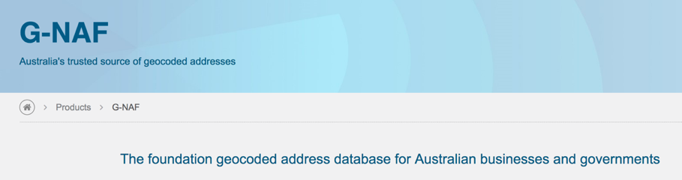
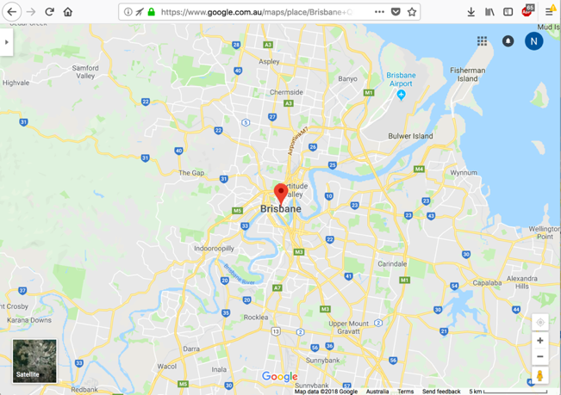
Public/Private collaboration
No-one has all the answers!
Case study: Google Maps Aust. & G-NAF
Authoritative data
Powerful technology & tools

Slide 7

Public/Private collaboration
No-one has all the answers!
Govt. wants to encourage the private sector
Leverage private sector agility
Leverage international expertise
Leverage specialisation & scale

Slide 8
Public/Private collaboration
No-one has all the answers!
Govt. wants to encourage the private sector
Leverage private sector agility
Leverage international expertise
Leverage specialisation & scale
Benefits to Australia
Better use of our data for our citizens
Supporting industry that can then operate independently of government too

Slide 9
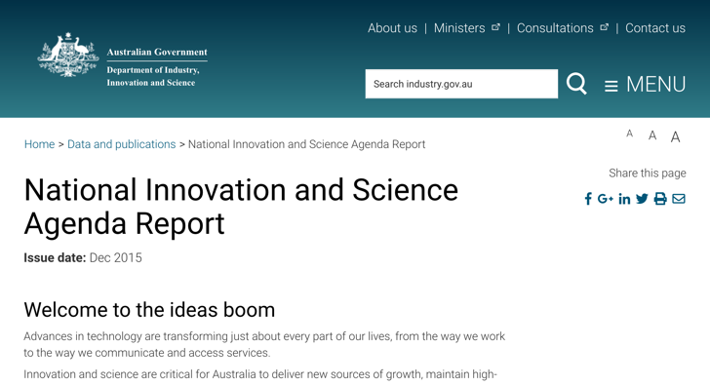
Public/Private collaboration
No-one has all the answers!
Govt. wants to encourage the private sector
Support via National Innovation & Science Agenda*
(Govt) Data sharing for innovation
Linkage Projects scheme: faster industry-research collaboration grants
Tax incentives for investors
Improving insolvency laws to encourage innovation
…
* https://www.industry.gov.au/data-and-publications/ national-innovation-and-science-agenda-report

Slide 10
Public/Private collaboration
No-one has all the answers!
Govt. wants to encourage the private sector
Government has uses for its own data
Wants to see private sector data added
Multi-dataset use
Multi-dataset use
Government data
Private Sector data

Slide 11
Outline
Public/Private collaboration
Big Data will evoke more collaboration between public and private sectors
Analytics for public service delivery
Analytics can contribute to smarter and more efficient methods of public service delivery
Real-time data adoption
The adoption of real time data can be used to monitor the public’s ecology and ecosystems better; including wants, needs, threats and opportunity

Slide 12

Analytics for public service delivery
MADIP
BLADE
Big Data projects lead by the Australian Bureau of Statistics

Slide 13
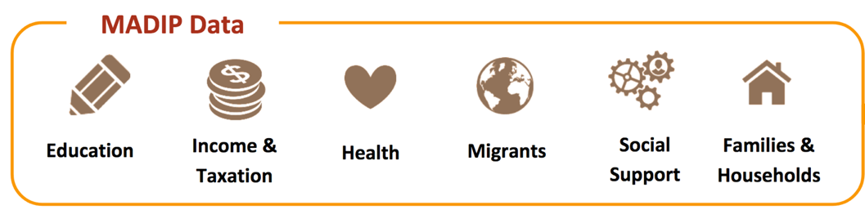
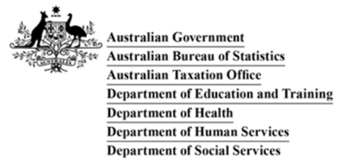
Multi-Agency Data Integration Project (MADIP)
Connecting nationally important datasets
To maximise public data value for policy analysis, research and statistics
http://www.abs.gov.au/websitedbs/ D3310114.nsf/home/Statistical+ Data+Integration+-+MADIP

Slide 14
Multi-Agency Data Integration Project (MADIP)
Demonstrating feasibility of linking existing public data to develop a more comprehensive picture of Australia and its people
Approved researchers and analysts can use the integrated data to improve our governance & economy
Shows agencies how existing data can be better used for insight into effectiveness of government policies, programs, and services
Now evaluating the potential of linked information for better targeting of services, such as health care and early childhood services

Slide 15
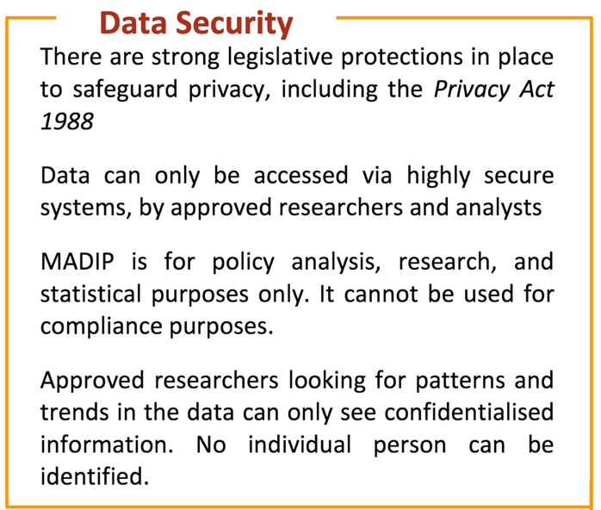
Multi-Agency Data Integration Project (MADIP)
Demonstrating feasibility of linking existing public data to develop a more comprehensive picture of Australia and its people
Approved researchers and analysts can use the integrated data to improve our governance & economy
Shows agencies how existing data can be better used for insight into effectiveness of government policies, programs, and services
Now evaluating the potential of linked information for better targeting of services, such as health care and early childhood services

Slide 16

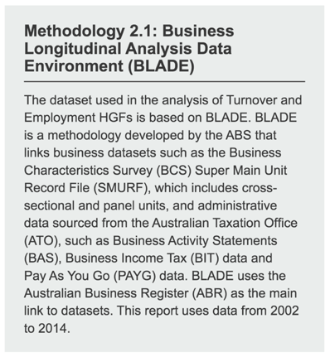
Business Longitudinal Analysis Data Environment (BLADE)*
A statistical resource containing information on Aust businesses
Helps researchers unlock insights on business & industry dynamics
Not a single dataset: it is a methodology for linking datasets
* http://www.abs.gov.au/websitedbs/D3310114.nsf/ home/Statistical+Data+Integration+-+Business+ Longitudinal+Analysis+Data+Environment+(BLADE)

Slide 17


BLADE
What can BLADE do?
track performance of businesses in Australia from 2000–01 onwards
track trends in business entry and exit rates, and survival rates over time
explore business characteristics such as:
export status
foreign ownership status
innovation status
provide insights into size & distribution of government program participants and impact programs have on businesses
+

Slide 18

BLADE
BLADE example – CleanTech
introduced in 2012 by the Australian government as part of the Clean Energy Act (2011) to help Australian firms to maintain their competitiveness while switching to a cleaner and more energy efficient capital equipment or technology.

Slide 19
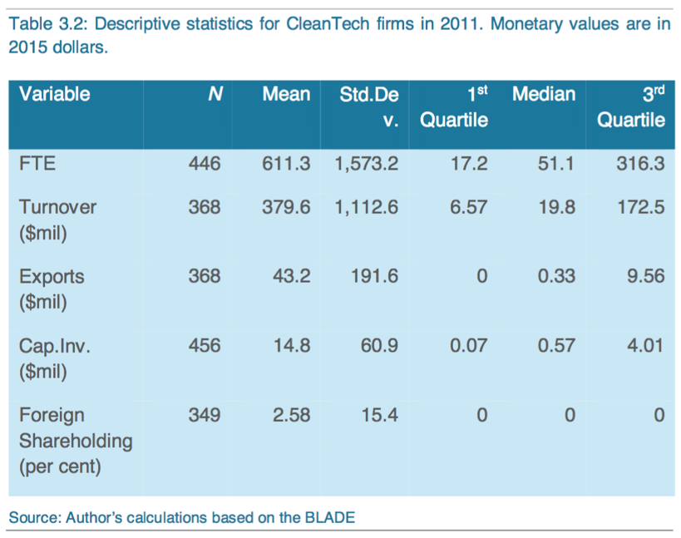
BLADE
BLADE data:

Slide 20
BLADE
“One notable finding from the tables is that firms receiving CleanTech are very likely to have zero percent foreign ownership. The majority of the grants went to fully Australian-owned firms. There are exceptions; for instance…”

Slide 21
MADIP & BLADE
Analytics hubs collect info from many sources: people and businesses
Include info about government services
Allow for an analysis of service outcomes

Slide 22
MADIP & BLADE
Analytics hubs collect info from many sources: people and businesses
Include info about government services
Allow for an analysis of service outcomes
Not open for non-government analysis, yet!

Slide 23

PEAN - Physical and Environmental Analytics Network
New hub: environmental data
Government ‘services’ for the environment tracked
Long-term views included

Slide 24
Outline
Public/Private collaboration
Big Data will evoke more collaboration between public and private sectors
Analytics for public service delivery
Analytics can contribute to smarter and more efficient methods of public service delivery
Real-time data adoption
The adoption of real time data can be used to monitor the public’s ecology and ecosystems better; including wants, needs, threats and opportunity

Slide 25
Real-time data adoption
Social
Environmental
Blends

Slide 26
Real-time data adoption
Social
MADIP + real time
Department of Human Services’ health and information deputy secretary Barry Sandison told delegates that it has a “gigantic database” of customer behaviour information.
“Every Australian is in the database and we divide our data sets into child support, Centrelink and Medicare. There are 23.5 million active records,” he said
DHS operates 27 call centres around Australia & measures how quickly call centre staff answer the phone

Slide 27
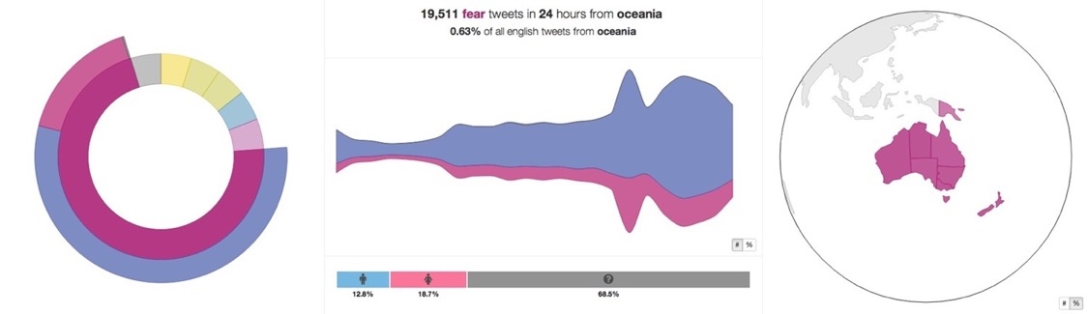
Real-time data adoption
Social
developed an online web tool called 'We Feel' for The Black Dog Institute (depression support institute)
analyses 32 000 tweets per minute, 27 million tweets per day
uses language-processing techniques to map words to a ‘wheel of emotions’
help understand how strongly our emotions depend on social, economic and environmental factors such as the weather, time of day, day of the week, news of a major disaster or a downturn in the economy

Slide 28
Real-time adoption
Environmental – Sentinel
Near real-time satellite data showing hot spots

Slide 29
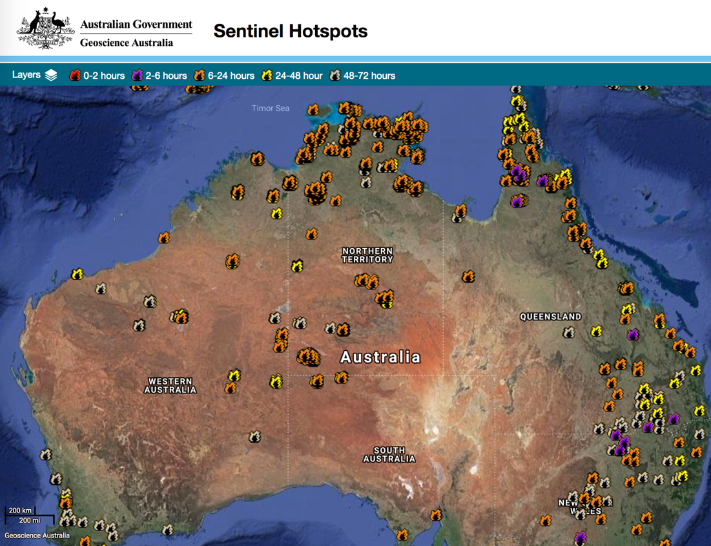

Slide 30
Real-time data adoption
Traditional govt. data (call center)
New social data (social media)
Social
Environmental
Scientific data
Starting to build analytics capability to compare, quickly!

Slide 31


Real-time data adoption
Scale is not really a problem
Call centers, Twitter, Satellite imagery…
Pipeline processing is now well-known
Text Natural Language Processing
Image processing…
It is the crossing of domains that is the key
Still more collaboration needed
More social than technical
Social
Environmental

Slide 32
Thank you
Nicholas Car
Senior Experimental Scientist
t +61 7 3833 5632
e nicholas.car@csiro.au
w https://people.csiro.au/Nicholas-Car
Land & Water

